Slide 1
Swine Disease Classification using Deep Learning
DATA 298B
Dr. Jerry Zeyu Gao
Team 7:
Hruthik Vinnakota
Jugal Kishore Ruvva
Rajeev Yenugula
Ramya Sudireddy

Slide 2
AGENDA
MACHINE LEARNING MODELS 3
MODEL COMPARISON 4
WEB SYSTEM DESIGN AND DEVELOPMENT 5
SYSTEM DESIGN AND IMPLEMENTATION 6
FUTURE SCOPE 11

Slide 3
Project Life Cycle
Data Collection
Data Collection
Deploy Models
Data Pre-Processing
Data Pre - Processing
ROAD MAP
Data Preparation
Models Evaluation
Model Development
Data Preparation
Model Evaluation
Model Development
Deploy Models
Notes:
In the ResNet architecture, audio inputs undergo a sequential processing pipeline, traversing through components such as the basic block, Res-n block, SE block, ReSE-n block, and feature recalibration. This structure enables the model to effectively capture and refine audio features at various levels, facilitating a comprehensive understanding of the input data. Ultimately, the output is generated based on the prescribed flow depicted in the diagram, resulting in refined and nuanced predictions.

Slide 4
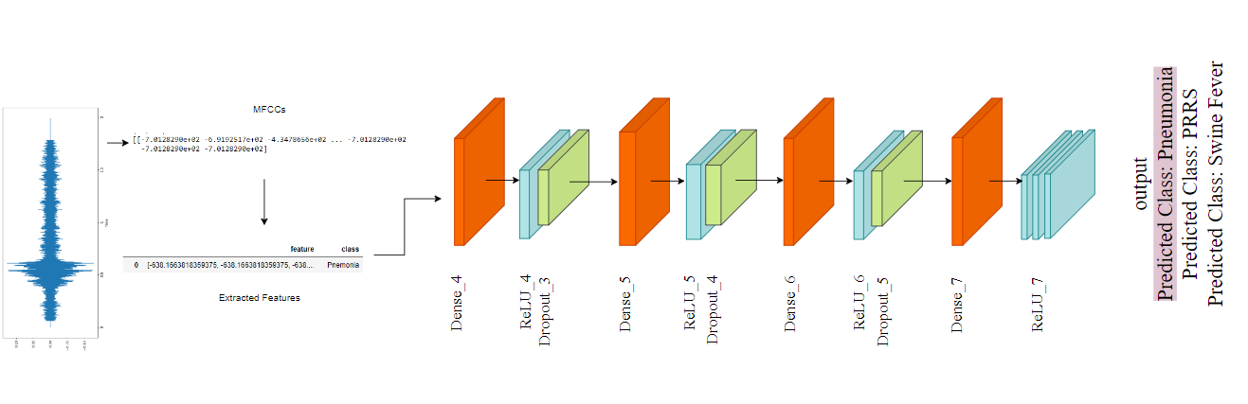
Proposed Models
DenseNet
Dense Convolutional Network (DenseNet):
A densely connected CNN architecture where each layer is connected to every other layer in a feed-forward fashion.
This connectivity pattern enhances feature propagation resulting in solid feature learning.
Notes:
Coming to the proposed models
Initially, we experimented with machine learning models such as SVC and random forest. Following the guidance of our professor, we transitioned to more advanced models, including DenseNet, ResNet, RNN, LSTM, and MobileNet, considered to be among the best in the field.
A DenseNet is a type of convolutional neural network that utilises dense connections between layers, through Dense Blocks, where we connect all layers (with matching feature-map sizes) directly with each other.

Slide 5
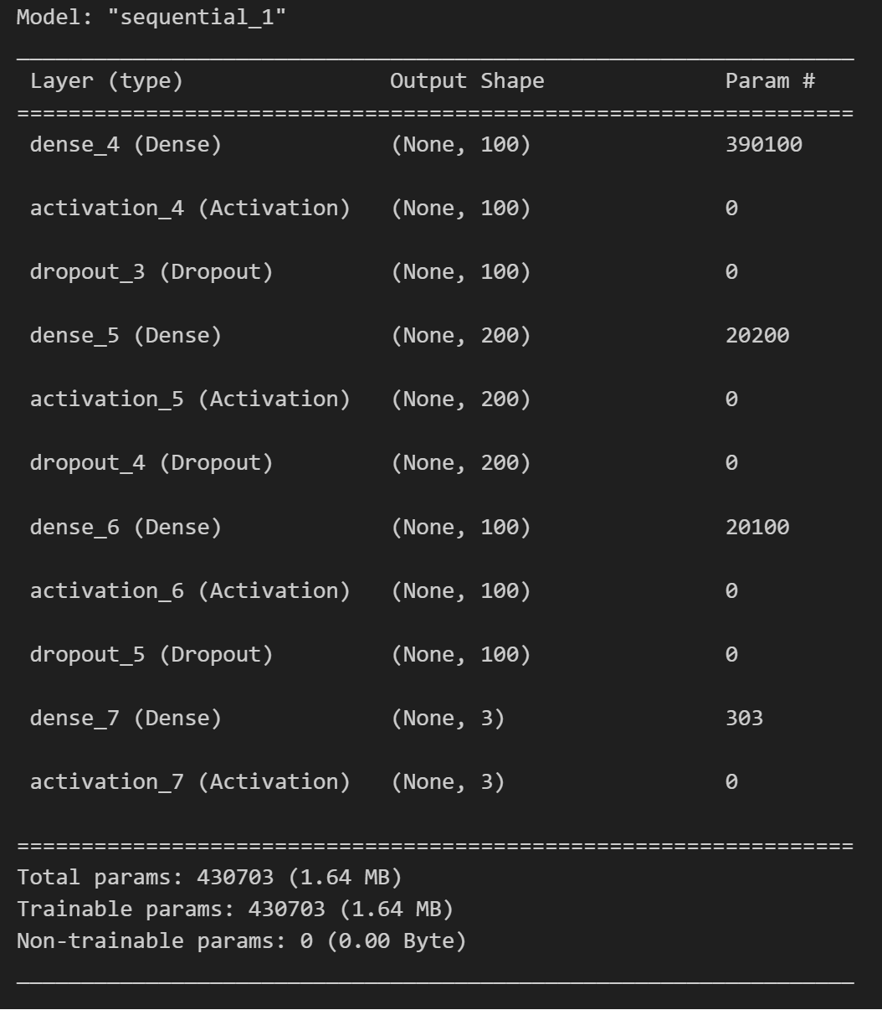
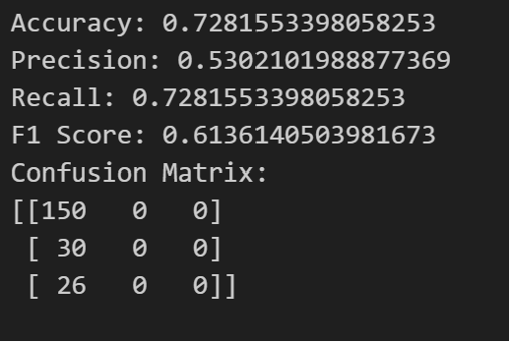
Proposed Models
DenseNet
DenseNet
“ReLU” Activation function to introduce non-linearity
Preventing overfitting
Output shape is 3 as total number of classes is 3
Notes:
This is the architecture of densenet
Here DenseNet employs the "ReLU" activation function to introduce non-linearity, while dropout is incorporated to prevent overfitting. The output shape is set to 3, reflecting the total number of classes in the classification task.

Slide 6
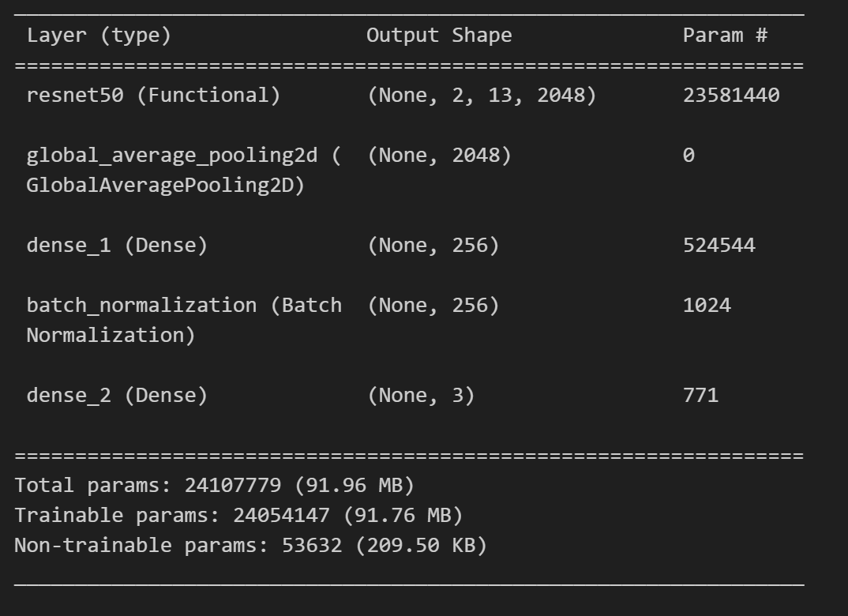
Proposed Models
ResNet
Residual Network (ResNet):
A deep neural network architecture known for effectively handling deep networks.
Its residual blocks help alleviate the vanishing gradient problem.
With 23,581,440 parameters, it constitutes the bulk of the model's complexity and capability
Helps in reducing overfitting by minimizing the total number of parameters in the model
Helps in reducing overfitting by minimizing the total number of parameters in the model

Slide 7
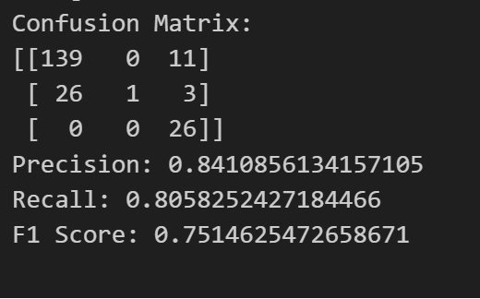
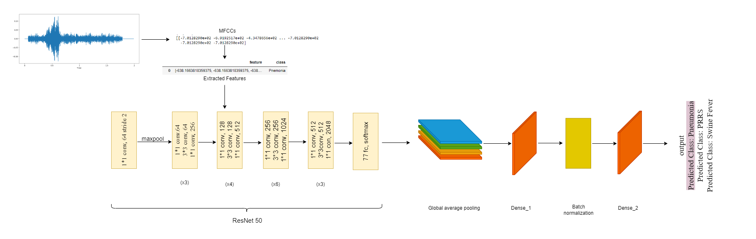
Proposed Models
ResNet
Notes:
In the ResNet architecture, audio inputs undergo a sequential processing pipeline, traversing through components such as the basic block, Res-n block, SE block, ReSE-n block, and feature recalibration. This structure enables the model to effectively capture and refine audio features at various levels, facilitating a comprehensive understanding of the input data. Ultimately, the output is generated based on the prescribed flow depicted in the diagram, resulting in refined and nuanced predictions.

Slide 8
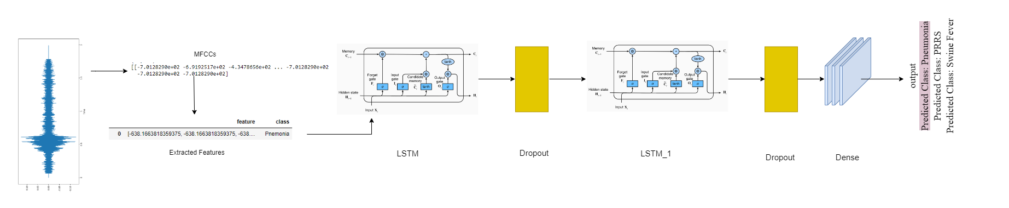
Proposed Models
Recurrent Neural Network
Recurrent Neural Network (RNN):
Specialized in processing sequences for tasks such as speech recognition or language modeling.
Capable of maintaining information in 'memory' over time to capture temporal dependencies.
Effective for analyzing time-series data or sequential data like audio signals, where past information influences the current state.

Slide 9
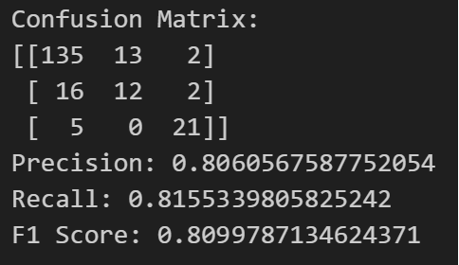
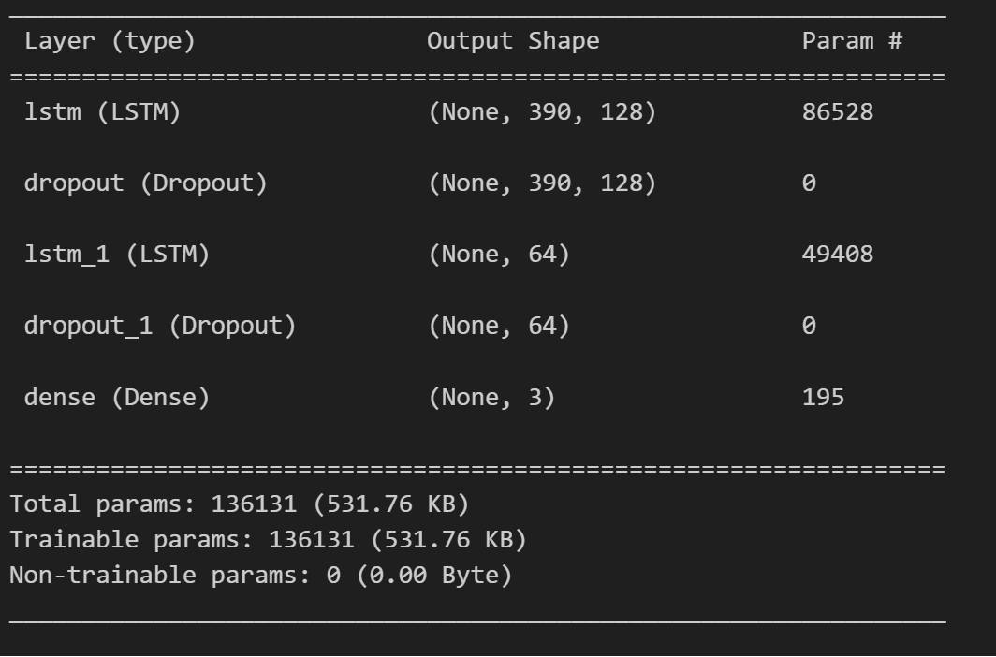
Proposed Models
Recurrent Neural Network
Helps combat overfitting by forcing the model to learn more robust features.
Does not return sequences, preparing the model for the final classification
Helps in reducing overfitting by minimizing the total number of parameters in the model
Notes:
This method helps the model avoid focusing too much on specific details, making it better at understanding different types of data. It also gets the model ready for the final decision without unnecessary information. By using fewer technical details, it prevents the model from becoming too specialized and helps it work well with various kinds of data.

Slide 10
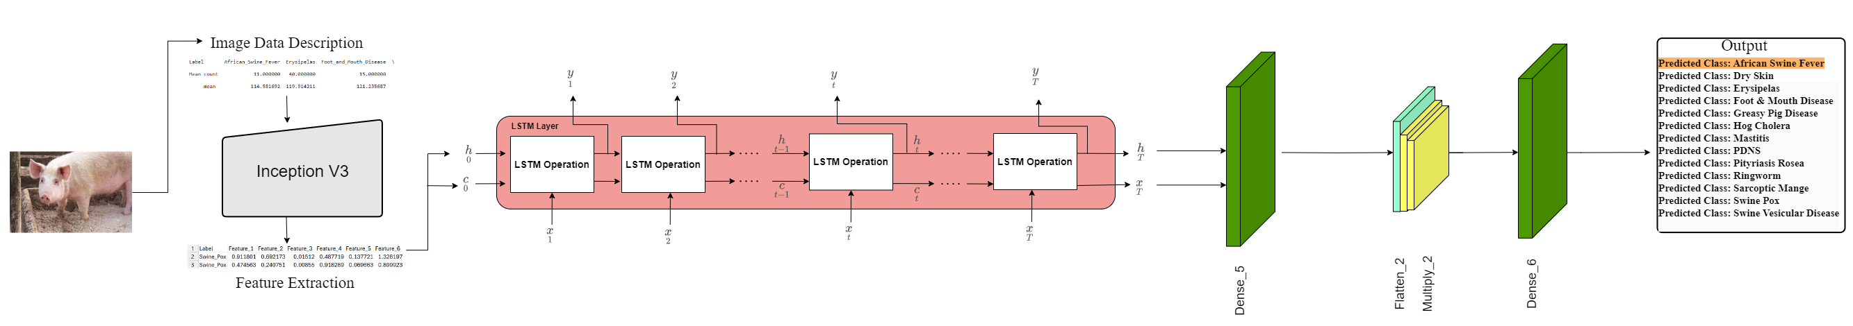
Proposed Models
LSTM
Long Short-Term Memory (LSTM):
Advanced RNN architecture capable of learning long-term dependencies in sequence data.
Ideal for time-series analysis, image classification, natural language processing, and speech recognition tasks.
Effectively handle sequences of image features, capturing temporal dynamics critical for understanding video and image.

Slide 11
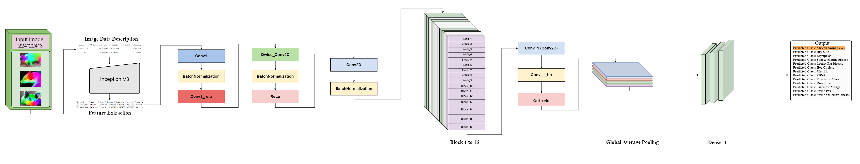
Proposed Models
MobileNet
MobileNet:
A class of efficient models for mobile and embedded vision applications.
Optimized for speed and size while maintaining accuracy, utilizing depth wise separable convolutions.
In this context, MobileNet can effectively process visual data with lower computational resources, making it suitable for real-time applications on mobile devices, such as facial recognition and object detection in images and video streams.

Slide 12
Model Comparison
MODEL | ACCURACY | PRECISION | RECALL | F1 SCORE
SVC | 75.72 | 78.72 | 75.72 | 76.77
Decision Tree | 80.09 | 80.88 | 80.09 | 80.44
Random Forest | 80.49 | 76.57 | 80.49 | 80.22
DenseNet | 74.75 | 53.02 | 72.75 | 61.48
Improved Models
DenseNet | 80.01 | 68.63 | 74.82 | 65.36
RNN | 81.55 | 80.61 | 81.55 | 80.99
ResNet | 80.58 | 84.11 | 80.58 | 75.15

Slide 13
Model Justification
Model | Approach | Strengths | Limitations
Recurrent Neural Network (RNN) | Hierarchical feature extraction for image data | - Well-suited for image-based tasks. - Automatically learns hierarchical features. | - Requires large amounts of labeled data for training.
Residual Network (ResNet) | Deep network architecture with residual connections | - Facilitates training of very deep neural networks. - Mitigates the vanishing gradient problem | - Increased complexity may lead to longer training times. - Difficulties in interpreting learned features in deep layers
Dense Convolutional Network (DenseNet) | Dense connectivity between layers | - Connects each layer to every other layer, encouraging feature reuse. - Addresses the vanishing gradient problem. | - Memory-intensive due to the dense connections.

Slide 14
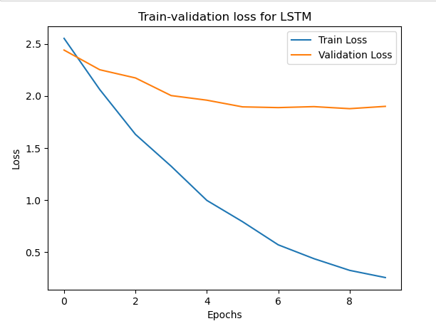
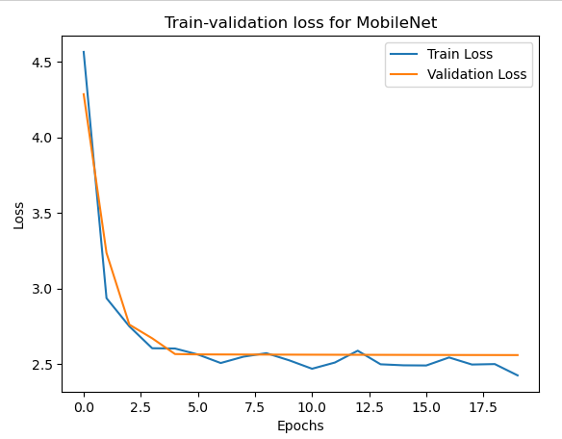
Model Comparison for image data

Slide 15
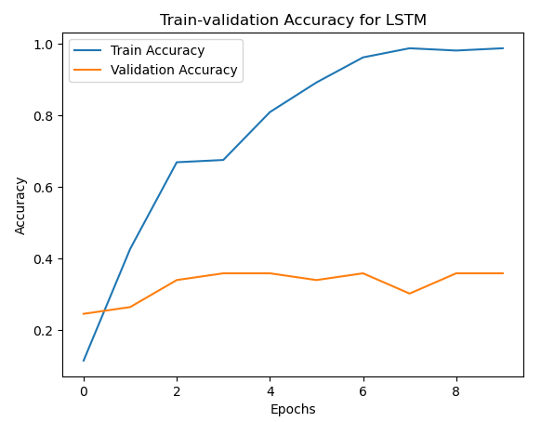
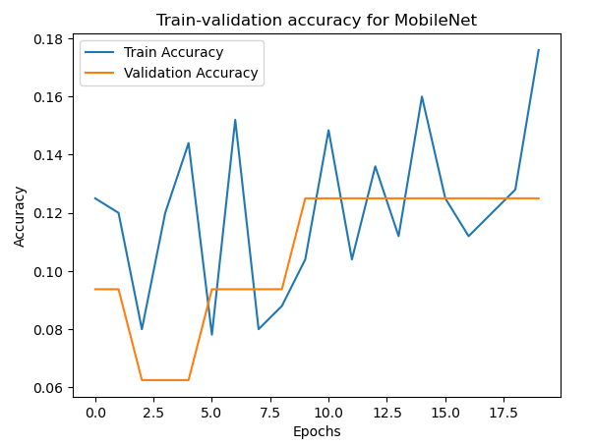
Model Comparison for image data

Slide 16
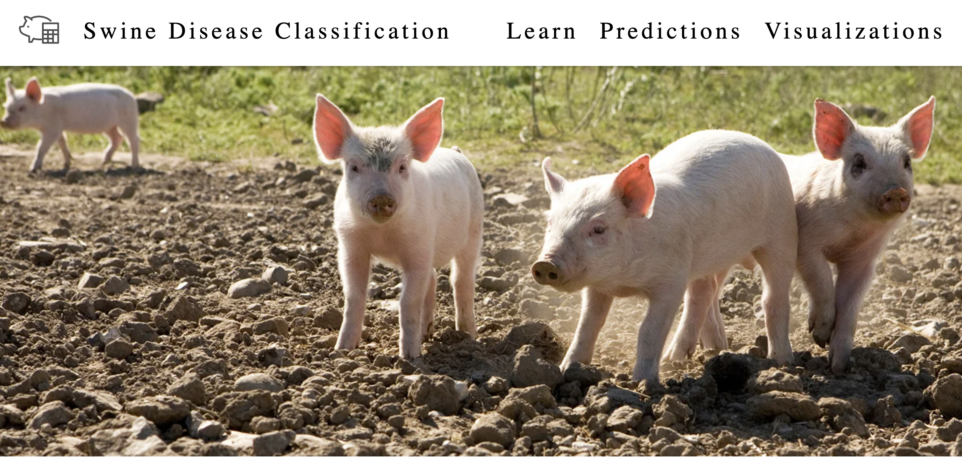
WEB-BASED SYSTEM IMPLEMENTION
Learn tab to discover detailed information about all 13 diseases
Prediction tab enables disease prediction utilizing a Deep Learning model running in the background.
Data visualization
Notes:
Our website has three tabs on the navigation bar. The "Learn" tab helps users find detailed information about all 13 diseases. In the "Prediction" tab, a smart system predicts diseases using a special model. Lastly, we use data visualization to make information easier to understand.

Slide 17
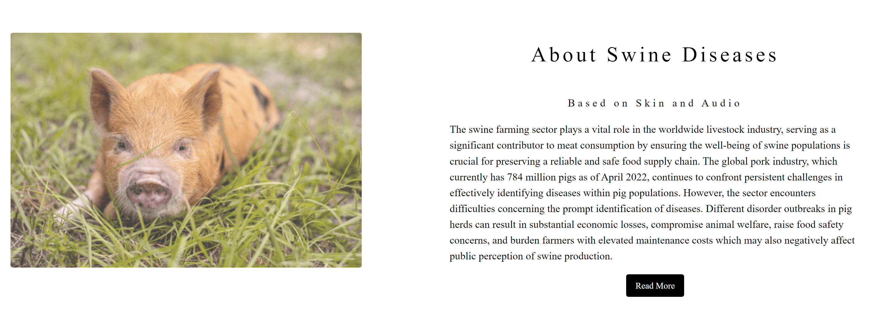
Learn Tab
Contains basic information about all 15 diseases (Reference: Iowa State University)
Enables the farmer to understand the disease better.
Helps the user to choose possible immediate action.
Notes:
Boost current deep learning structures and methods to enhance model efficacy on visual and auditory datasets.
Can Modify the models' hyperparameters and regularization strategies.
Can Create realistic audio samples for data enhancement by integrating Generative Adversarial Networks (GANs).
Coming to Leveraging Transfer Learning:
To apply knowledge from large-scale datasets to particular picture and audio tasks, can use transfer learning techniques and pre-trained models.
Optimize pre-trained models using target datasets to make use of obtained features and boost training efficiency.
Investigate combined methods to merge forecasts from various models, relying on the advantages of every architecture to enhance overall performance across various datasets.

Slide 18
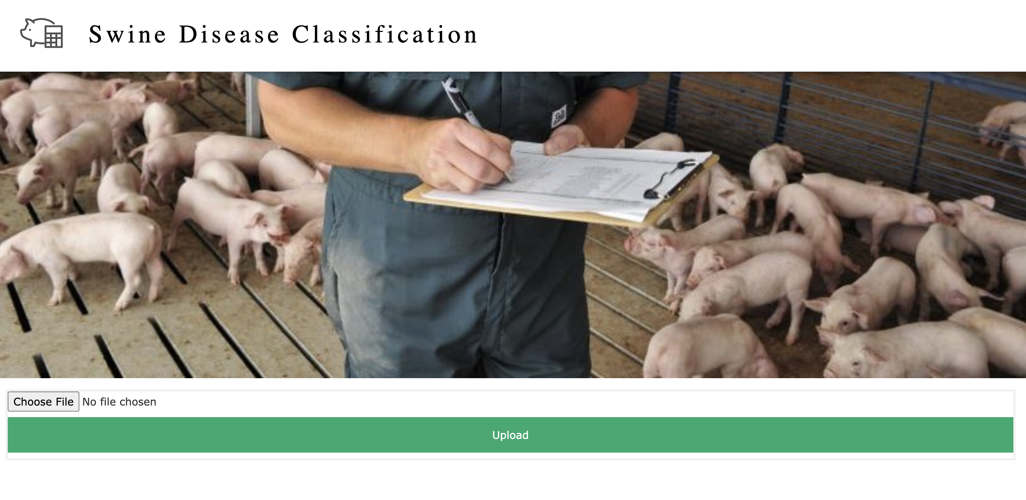
Predictions Tab
Only authorized user can access this page.
Allow the user to upload audio, images and video data.
Classify the disease and displays the statistics.
Notes:
Boost current deep learning structures and methods to enhance model efficacy on visual and auditory datasets.
Can Modify the models' hyperparameters and regularization strategies.
Can Create realistic audio samples for data enhancement by integrating Generative Adversarial Networks (GANs).
Coming to Leveraging Transfer Learning:
To apply knowledge from large-scale datasets to particular picture and audio tasks, can use transfer learning techniques and pre-trained models.
Optimize pre-trained models using target datasets to make use of obtained features and boost training efficiency.
Investigate combined methods to merge forecasts from various models, relying on the advantages of every architecture to enhance overall performance across various datasets.

Slide 19
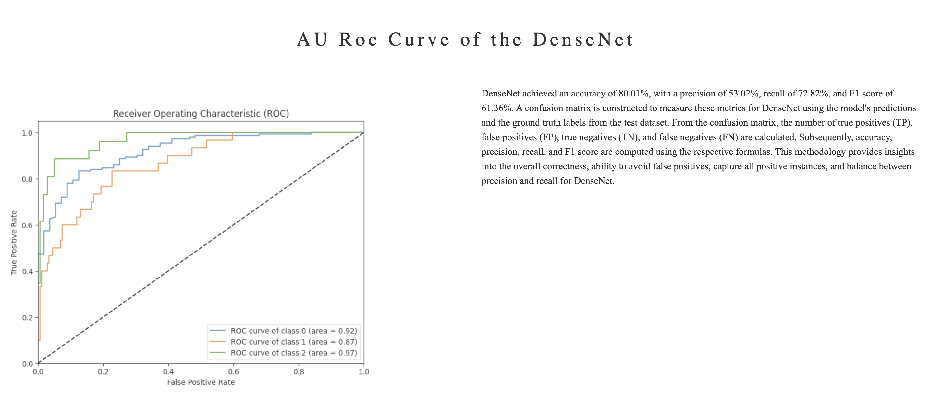
Visualizations Tab
A dashboard of visualizations related to the results.
Visualizes the model performance.
Notes:
Boost current deep learning structures and methods to enhance model efficacy on visual and auditory datasets.
Can Modify the models' hyperparameters and regularization strategies.
Can Create realistic audio samples for data enhancement by integrating Generative Adversarial Networks (GANs).
Coming to Leveraging Transfer Learning:
To apply knowledge from large-scale datasets to particular picture and audio tasks, can use transfer learning techniques and pre-trained models.
Optimize pre-trained models using target datasets to make use of obtained features and boost training efficiency.
Investigate combined methods to merge forecasts from various models, relying on the advantages of every architecture to enhance overall performance across various datasets.

Slide 20
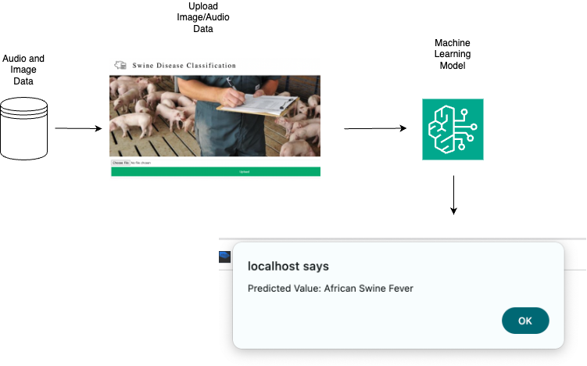
Web Based Implementation
Notes:
Boost current deep learning structures and methods to enhance model efficacy on visual and auditory datasets.
Can Modify the models' hyperparameters and regularization strategies.
Can Create realistic audio samples for data enhancement by integrating Generative Adversarial Networks (GANs).
Coming to Leveraging Transfer Learning:
To apply knowledge from large-scale datasets to particular picture and audio tasks, can use transfer learning techniques and pre-trained models.
Optimize pre-trained models using target datasets to make use of obtained features and boost training efficiency.
Investigate combined methods to merge forecasts from various models, relying on the advantages of every architecture to enhance overall performance across various datasets.

Slide 21






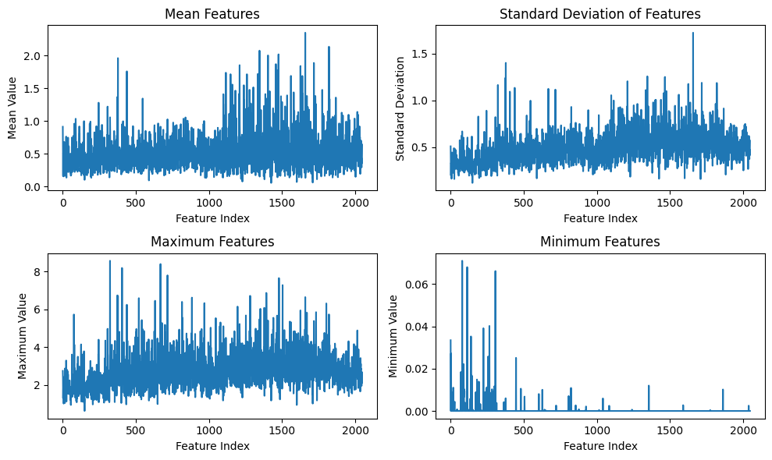

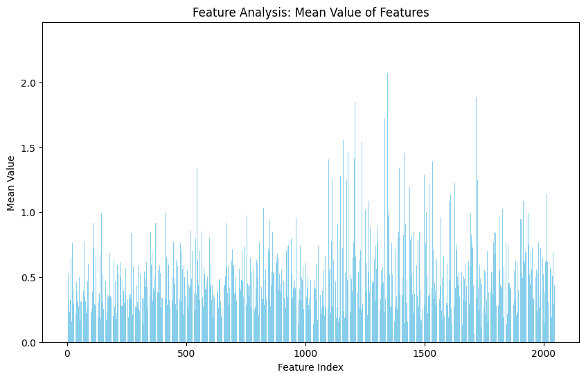


System Design Architecture
Request
HTML
Front End
Response
JSON
User
Audio Data Type
Image Data Type
Link Classification
.Py
Prediction Results
Model 1
Model 3
Dense Net
Model 1
GUI Detection
Dense Net
LSTM
Model 2
RNN
Visualizations
Model 2
Model 3
MobileNetV2
Res Net
Pipelines to develop simulations
Error Handling
Virtual graphs of both Image & Audio
Data Integration
Audio Data
Image Data
Model Evaluation
Back End
Database

Slide 22
Future Scope
Enhanced Accuracy
Continuously improving the accuracy of disease classification algorithms through fine-tuning.
2. Real-Time Monitoring
Developing systems for real-time monitoring of swine health status, allowing for timely disease detection and intervention.
3. Collaborative Research
Collaborating with research institutions and industry partners to gather extensive datasets and foster innovation in swine disease classification methodologies.
4. Leveraging Transfer Learning
Utilize pre-trained models and transfer learning techniques to adapt knowledge from large-scale datasets to specific image and audio tasks.
Fine-tune pre-trained models on target datasets to leverage learned features and accelerate training while improving performance.
Notes:
Boost current deep learning structures and methods to enhance model efficacy on visual and auditory datasets.
Can Modify the models' hyperparameters and regularization strategies.
Can Create realistic audio samples for data enhancement by integrating Generative Adversarial Networks (GANs).
Coming to Leveraging Transfer Learning:
To apply knowledge from large-scale datasets to particular picture and audio tasks, can use transfer learning techniques and pre-trained models.
Optimize pre-trained models using target datasets to make use of obtained features and boost training efficiency.
Investigate combined methods to merge forecasts from various models, relying on the advantages of every architecture to enhance overall performance across various datasets.

Slide 23
Thank You

